Slide 1


Stock Price Prediction and GameStop Short Squeeze
By: Davis Craig

Slide 2
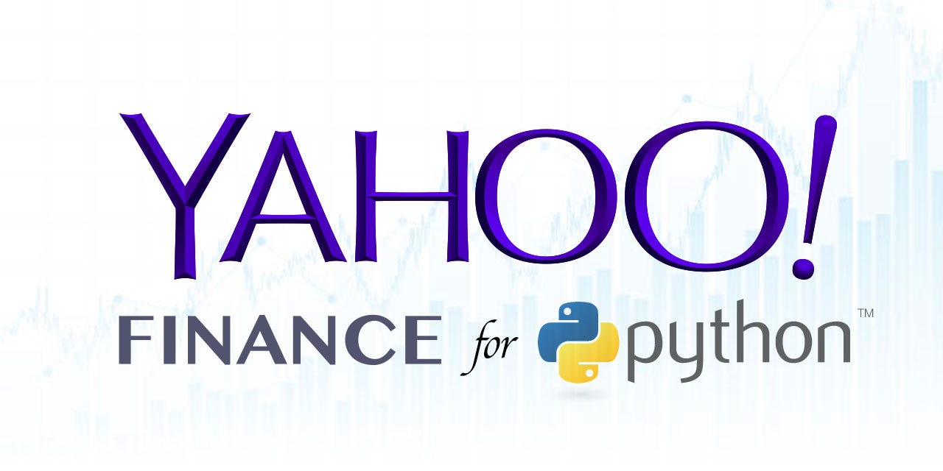

Gathering Data
To gather stock data for Gamestop I used yahoo finance’s finance python package
I pulled daily stock data for the period 2021-01-01 to 2021-12-31 (this time period aligns with the Reddit post data I collected)
For each day I gathered the opening price, high price, low price, close price, and total volume
I used the Harvard dataverse set on Reddit WallStreetBets Posts for sentiment analysis data

Slide 3
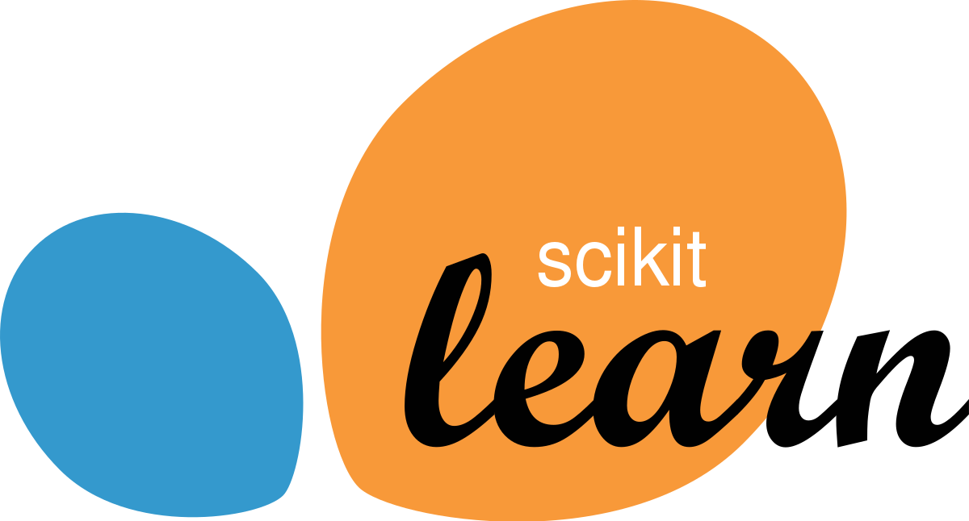
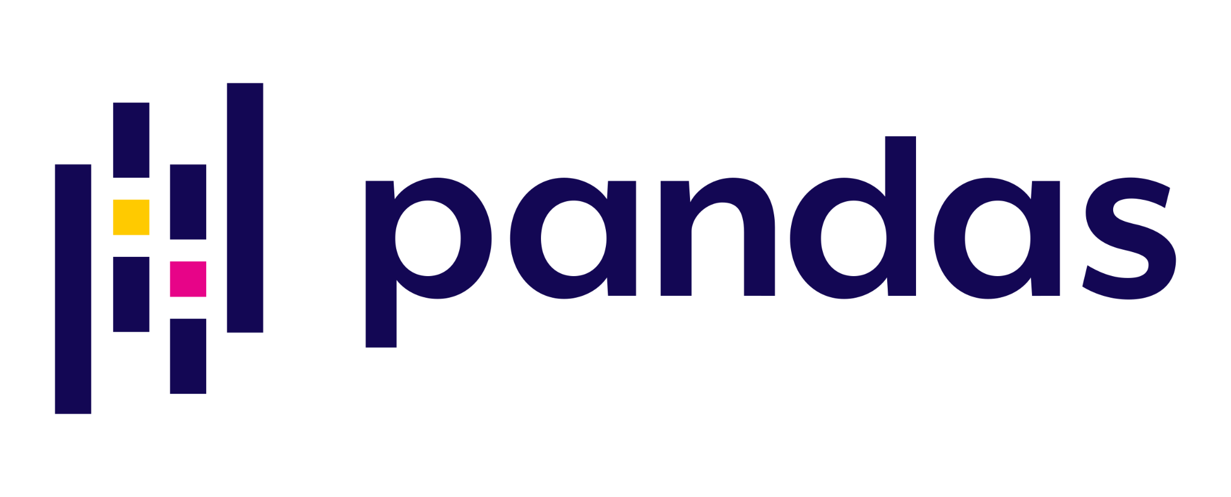
Prediction Label & Feature Engineering
Time Series Financial Forecasting
Sentiment Analysis
For the prediction label I used the closing stock price
From the stock data I used low, high, opening, and volume as features
For pre-processing I scaled these features using the scikit learn MinMaxScaler
Used the composite sentiment scores from the Harvard dataverse Wall Street Bets dataset
Since there were multiple reddit posts a day, I used pandas to aggregate the posts by day and took their average composite sentiment score

Slide 4
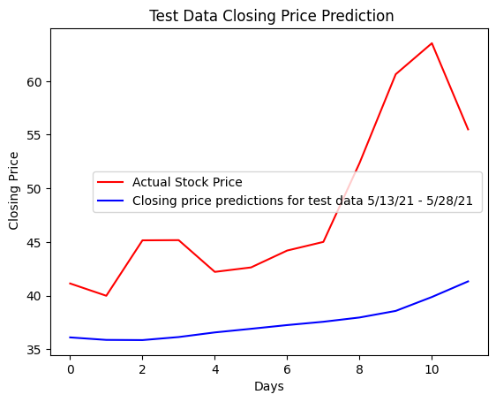


Model Building
Fused Model
Took results from sentiment analysis and used them as feature in time-series dataset
Passed this new data-set into the original time-series forecasting model to predict closing price based off both historical stock data and sentiment
Time-series forecasting
Multivariate time series forecasting using LSTM (based on this github repo)
Implemented with Tensorflow
Used gridsearch to tune hyper parameters
Sentiment Analysis
Composite sentiment scores obtained with Vader using a lexicon where each word is labeled with a sentiment score. Each word is vectorized and scored, then, the scores are adjusted for context, aggregated, and normalized between 1 and -1 to create the composite sentiment score.

Slide 5
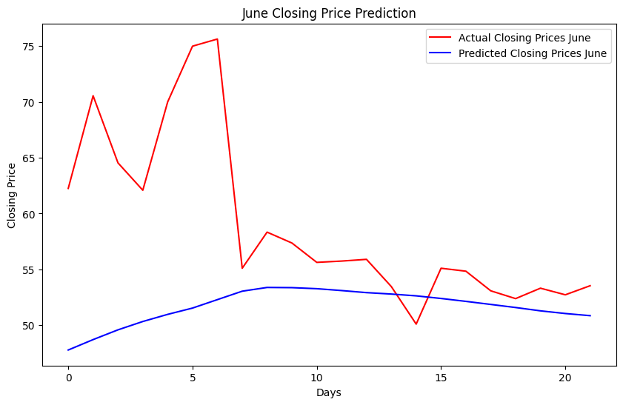
Closing Price Predictions for June
Mean Squared Error (MSE): 118.74
Root Mean Squared Error (RMSE): 10.9
Mean Absolute Error (MAE): 7.5
The model smooths out to show general trends, but lags when spikes hit such as around 5 days into June.

Slide 6
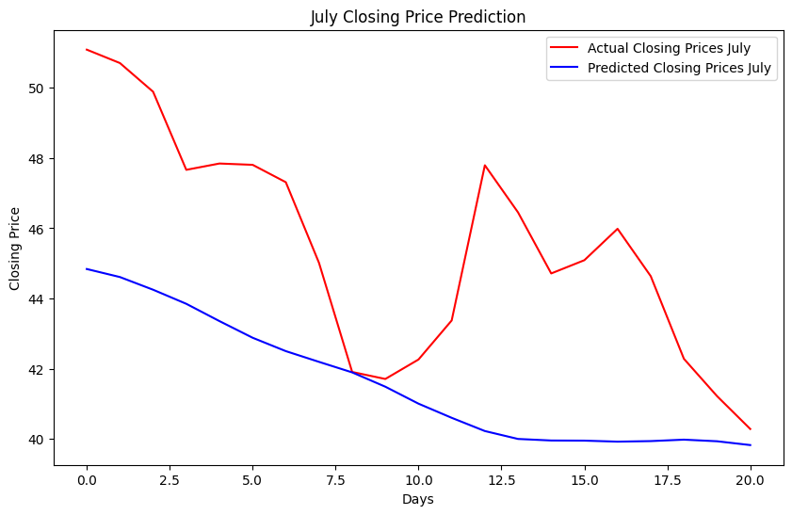
Closing Price Predictions for July
Mean Squared Error (MSE): 20.09
Root Mean Squared Error (RMSE): 4.48
Mean Absolute Error (MAE): 3.9
The model seems to take the average trend and misses quite a large spike around 10-12 days into July.

Slide 7
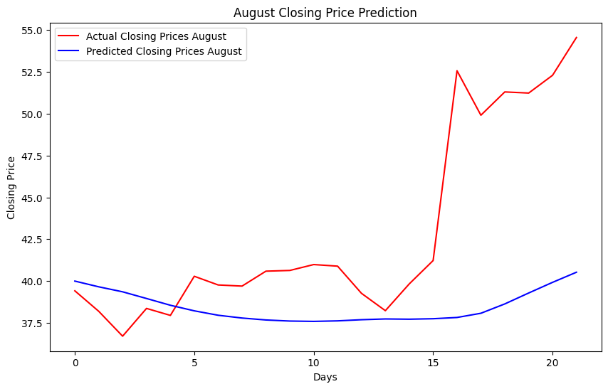
Closing Price Predictions for August
Mean Squared Error (MSE): 49.66
Root Mean Squared Error (RMSE): 7.05
Mean Absolute Error (MAE): 4.98
The model is lagging by about a day which you can see by looking at the last few days of August where it jumps on day 17 after the major spike on day 16.

Slide 8
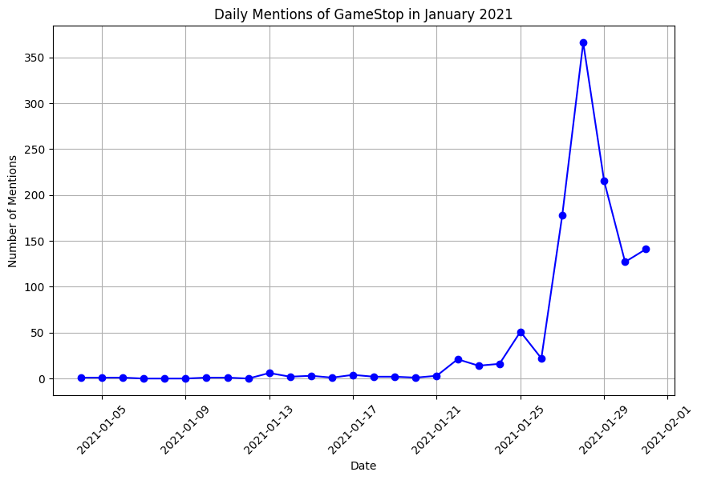
Event Analysis - Named-Entity Mentions
After using Spacy to perform Named Entity Recognition for Gamestop on the Wallstreetbets Reddit post titles from the Harvard dataset for the month of January we can see a major spike in discussions about Gamestop at the end of the month. This aligns closely with the short-squeeze that occurred during this time.

Slide 9
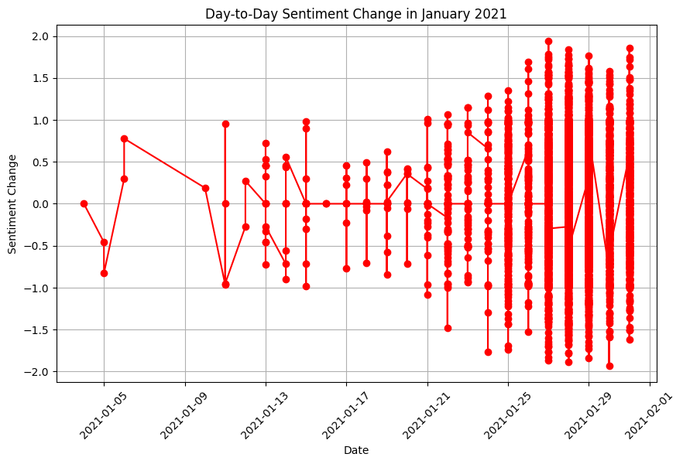
Event Analysis - Sentiment Change
In terms of sentiment during this time what we see is that in addition to there being a higher volume of post, there is greater volatility in sentiment. Extremely negative and positive posts characterized the short-squeeze.

Slide 10
Event Analysis - January Topics
After performing LDA on the topics for each week and using GPT-4 to summarize the results we can see that from the beginning of the month strategizing around a short squeeze was underway, which led into buying momentum, and holding.
Week 1:
Focused discussions on an imminent short squeeze involving GameStop (GME), with a significant emphasis on a strategic 'pump' and an upcoming conference on January 11th. The community is actively engaged in detailed strategy talks and preparations.
Week 2:
Conversations center around tactical approaches and stock analyses, including Ryan Cohen's influence on GME, technical stock assessments, and a collective push for a short squeeze, coupled with comparisons to other stocks like PLTR.
Week 3:
The narrative shifts to strategic planning for a short squeeze, with emphasis on holding and buying GME, coordinated actions through platforms like WallStreetBets, and a community-driven stand against institutions like Melvin Capital.
Week 4:
The community sustains its momentum with continued encouragement to buy and hold GME, marked by emotional appeals for solidarity, discussions on wider market dynamics, and the role of platforms like Robinhood.

Slide 11
Model Sensitivity
Looking at the month of August we see that the biggest percentage change in actual values, 27.5, occurred on August, 23rd whereas the biggest percentage change in predicted values, 1.69, occurred on August 26th.
In terms of sensitivity we see that the model is not sensitive enough to changes in the data. Even when it reacts to changes in the data, it does with too conservative of a sensitivity to the volatility of the real data.
We also see that the second biggest swing in sentiment of the entire month occured on the 24th, likely a response to the big jump on the 23rd. Once again whether it is the stock price or sentiment data, the model lacks the sensitivity to respond to the magnitude of these changes.

Slide 12
Algorithmic Adjustments
Training the model on hourly stock price data for hourly predictions could be more effective than daily predictions. This approach would also allow for more efficient use of post data through hourly aggregation.
Increase the number of layers in the LSTM neural network
Implement bidirectional functionality to capture more insightful patterns from the data
Implement attention mechanism or change from LSTM to transformer architecture
Look more deeply at the natural language meaning of the reddit data, using vector embeddings and other advanced NLP methodologies

Slide 13
Key Findings
Gamestop’s Short Squeeze was strategically planned and maintained on the Wallstreetbets Reddit page
Sharp rises in price were strongly correlated with a rise in volume of posts on GME as well as higher volatility of sentiment in posts on GME
The model had low accuracy on stock price prediction, but was capable of picking up general trends
Much of the accuracy issues stemmed from a lack of sensitivity, where it did not adequately adjust to the magnitude of change
Overall the model was limited in its capability to respond with enough sensitivity to changes in sentiment and price data. With more data and training the model would likely make significant improvements.

Slide 14
Short Squeeze Impact
The impact of retail investors orchestrating short-squeezes through platforms such as Reddit cannot be underestimated. They were able to force large hedge funds to take massive losses, and create thousands of percentage point increases for a stock.
Looking ahead the meme stock craze backed by armies of retail investors will be a phenomena that continues to play out. Likely, this will occur most often when interest rates are low and cash is cheap.
Overall, the GME short squeeze showed this was possible, and now is an opportune time to build deep learning models to help predict the next one.

Slide 15
Future Research
During topic modeling and in review of the Wallstreetbets post data we saw that there were many other meme stocks, such as Palantir (PLTR). Similar analysis could be performed on these stocks, and an ensemble model could be built encompassing the different learned patterns to make more powerful predictions.
Further research should be performed on what kinds of strategic action are being taken to orchestrate short-squeezes. Especially actions that leave a data trail. These insights could lead to useful features to incorporate into models.
A comparative analysis between a traditional short-squeeze and a retail investor short squeeze could further reveal what makes this new phenomenon unique

